Slide 1
React Class Component Life Cycle Methods

Slide 2
Contents
Mounting
Updating
UnMounting
Error Handling

Slide 3
Mounting
These methods are called in the following order when an instance of a component is being created and inserted into the DOM
constructor()
static getDerivedStateFromProps()
render()
componentDidMount()

Slide 4
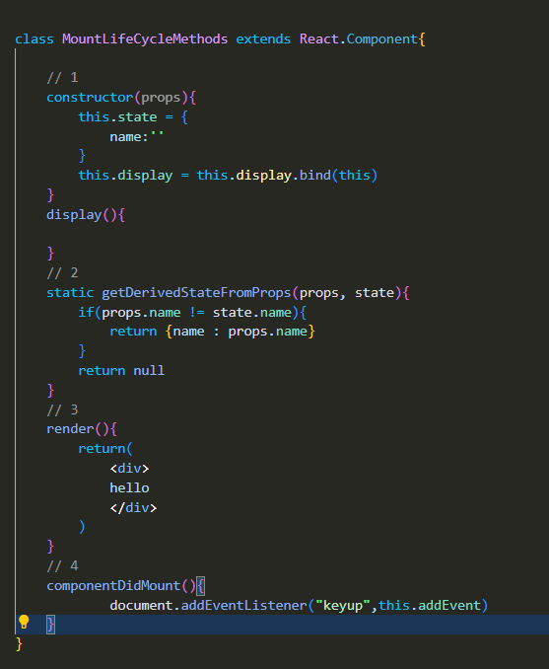

Slide 5
Updating
An update can be caused by changes to props or state. These methods are called in the following order when a component is being re-rendered
static getDerivedStateFromProps()
shouldComponentUpdate()
render()
getSnapshotBeforeUpdate()
componentDidUpdate()

Slide 6
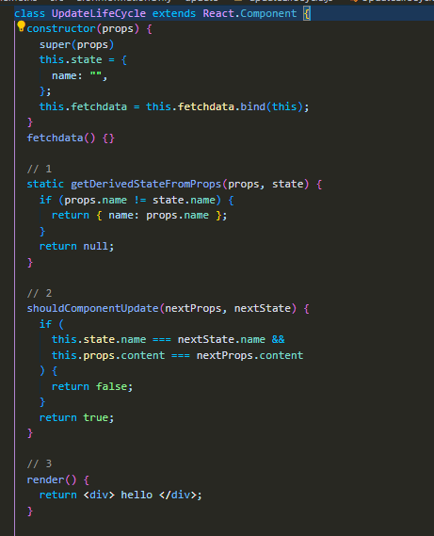
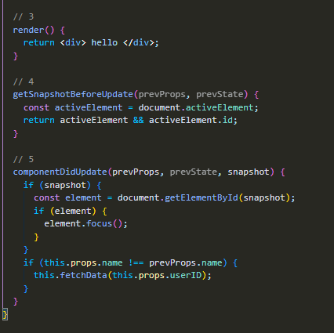

Slide 7
Unmounting
This method is called when a component is being removed from the DOM
componentWillUnmount()

Slide 8
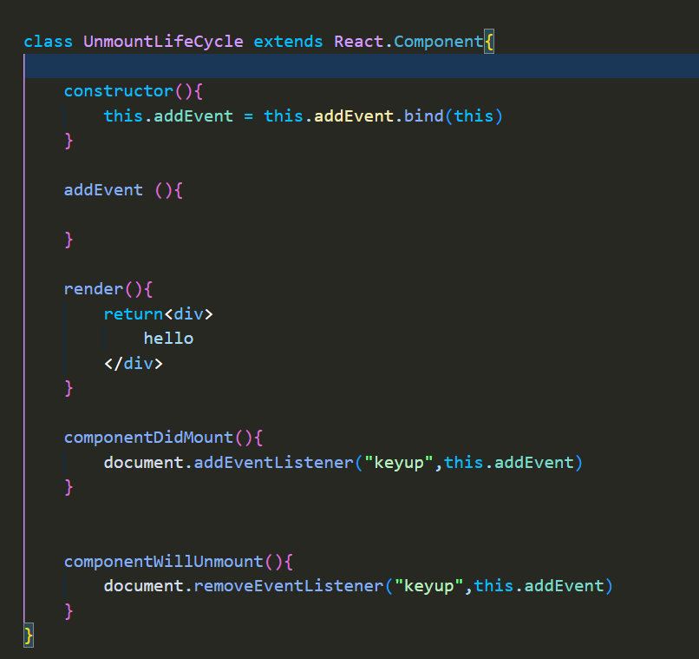

Slide 9
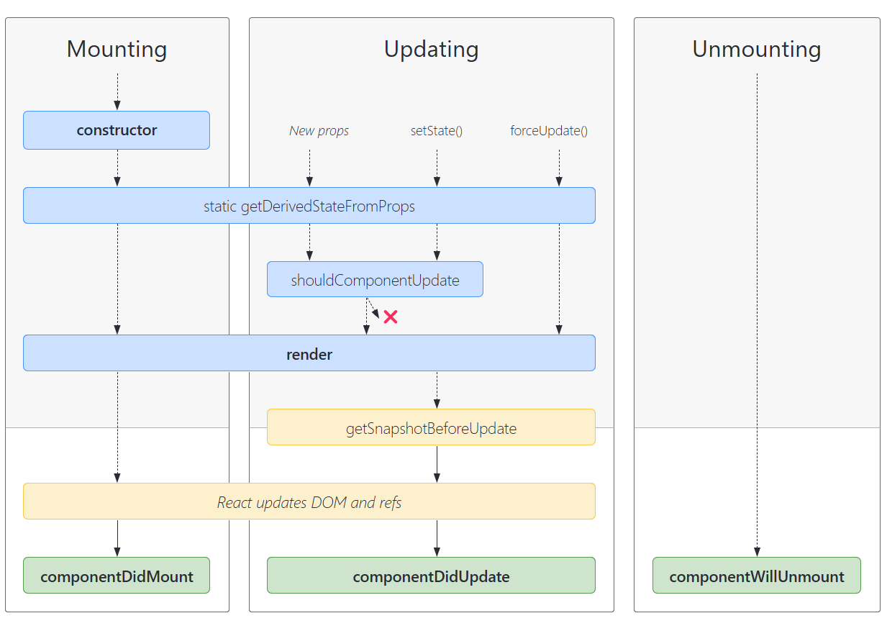

Slide 10
Error Handling
These methods are called when there is an error during rendering, in a lifecycle method, or in the constructor of any child component.
static getDerivedStateFromError()
componentDidCatch()

